Slide 1
Lesson 9: Indexing Structures
CSC430/530 – DATABASE MANAGEMENT SYSTEMS

Slide 2
OUTLINE
Introduction.
Data storage principles.
File records.
Spanned vs. unspanned records.
File organizations.
Hashing techniques.
Indexing structures.
Primary indexes.
Clustering indexes.
Secondary indexes.
Multi-level indexes.

Slide 3
INTRODUCTION
Storage hierarchy:
Primary storage.
CPU memory, cache memory.
Secondary storage (mass storage).
Magnetic disks, flash memory, solid-state drives.
Tertiary storage.
Removable media.
Data in databases is typically stored on magnetic disks or solid-state drives.
Accessed using physical database file structures.

Slide 4
FILE RECORDS
Record is a unit of measure with respect to the storage structures.
Tuples (rows) in a relation (table) are represented as records.
Records comprise of a sequence of fields (column, attribute)
Files on a disk comprised of sequences of records.
Two general types of records:
Fixed-length records.
Every record has exact same size.
Variable-length records.
Different records have different sizes.

Slide 5
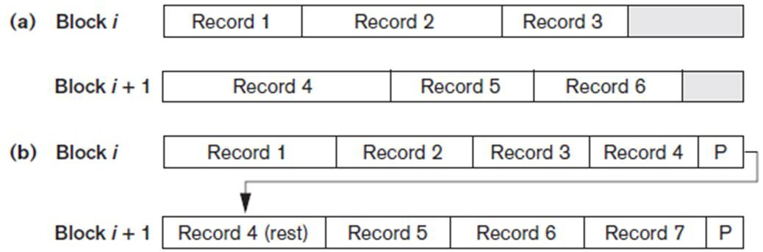
SPANNED VS UNSPANNED RECORDS
File records are allocated to disk blocks.
Blocks refer to physical units of storage in storage devices.
Examples: sectors in hard disks or pages in virtual memory.
Records are classified based on the block occupation:
Unspanned records
Records not allowed to cross block boundaries.
Spanned records
Larger than a single block.
Pointer at end of first block points to block containing remainder of record.
Unspanned (a) & Spanned (b) records.

Slide 6
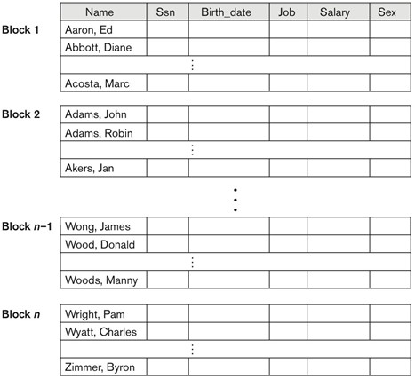
FILE ORGANIZATIONS
Relations (tables) are stored in files as logical “records” & read in terms of physical “blocks”.
File organization refers to the way records are stored in terms of blocks and the way blocks are
placed on the storage medium and interlinked.
Types of file organizations:
Unsorted files.
Records placed in file in order of insertion
Sorted files.
Records sorted by ordering field (key field).
Hash files.
Maps data of arbitrary size to data of fixed size.
Key-value mapping.
Sorted file organization.

Slide 7
HASHING TECHNIQUES (1)
Each record in a hash file contains a special hash field (hash key).
Key field of a hash file.
Hash function (randomization function) is applied on the hash field value of record.
Yields the address of the disk block where the record is stored.
Two types of hashing techniques:
External hashing.
Operates on disk files.
Internal hashing.
Operates on records in files.
Group of records is accessed by using value of one field.
Examples: dictionaries or hash tables.

Slide 8
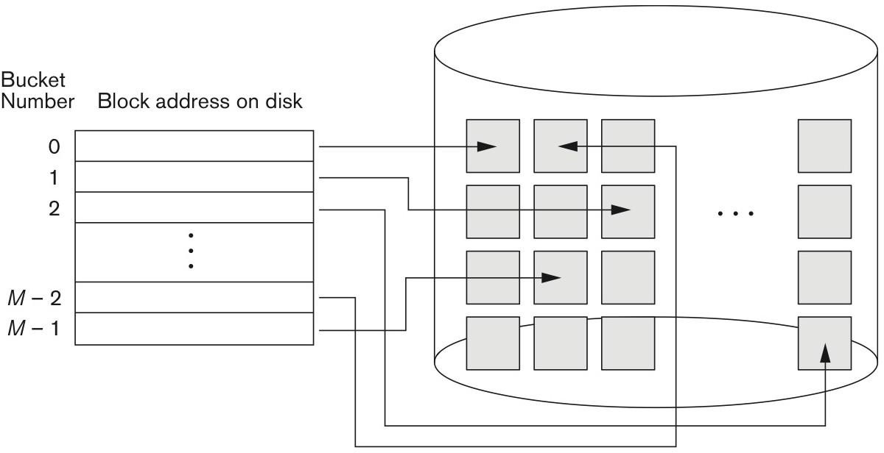
HASHING TECHNIQUES (2)
In external hashing target address space is made of “buckets”.
Bucket – single disk block or contiguous blocks.
Hashing function maps key into relative bucket.
Table in file header converts bucket number into disk block address.
Two types of external hashing:
Static hashing
Allocates fixed number of buckets.
Dynamic hashing.
Allows number of buckets to grow and shrink dynamically.
Matching bucket numbers to disk block addresses.

Slide 9
HASHING TECHNIQUES: COLLISIONS
Hashing techniques are prone to collision issue.
Collision - hash field value for inserted record hashes to address already containing a different record.
Collision resolving techniques:
Open addressing.
Algorithm checks subsequent addresses to find an empty one.
Chaining.
New empty address is referred to by the pointer of occupied hash address.
Multiple hashing.
Second hash function is applied if the first resulted in collision.

Slide 10
INDEXING STRUCTURES
Index – auxiliary access structure used to speed up the retrieval of the records.
Index structures are additional files on disk that provide secondary access path to data files.
Indexes are comprised of two fields: indexing attribute & storage block pointer.
Any attribute can be indexed.
Multiple indexes on different attributes.
Indexes on multiple attributes.
Indexing structures are similar to indexing in books:
Important terms = indexing attributes.
Page numbers = pointers to file blocks.
Types of indexes:
Single-level indexes.
Primary indexes, clustering indexes & secondary indexes.
Multi-level indexes.

Slide 11
PRIMARY INDEXES (1)
Primary indexes are used when data file is ordered by primary key attributes.
Primary index is an ordered file with two fields:
Primary key K(i).
Indexing attribute.
Pointer to disk block P(i).
Examples:
<K(1) = (Aaron, Ed), P(1) = address of block 1>
<K(2) = (Adams, John), P(2) = address of block 2>
Primary index file contains one index entry for each block in the data file.
First record of each block is an anchor record.
Two types of single-level indexes:
Dense indexes.
Index entry for every search key value in the data file.
Sparse indexes.
Entries for only some search values.

Slide 12
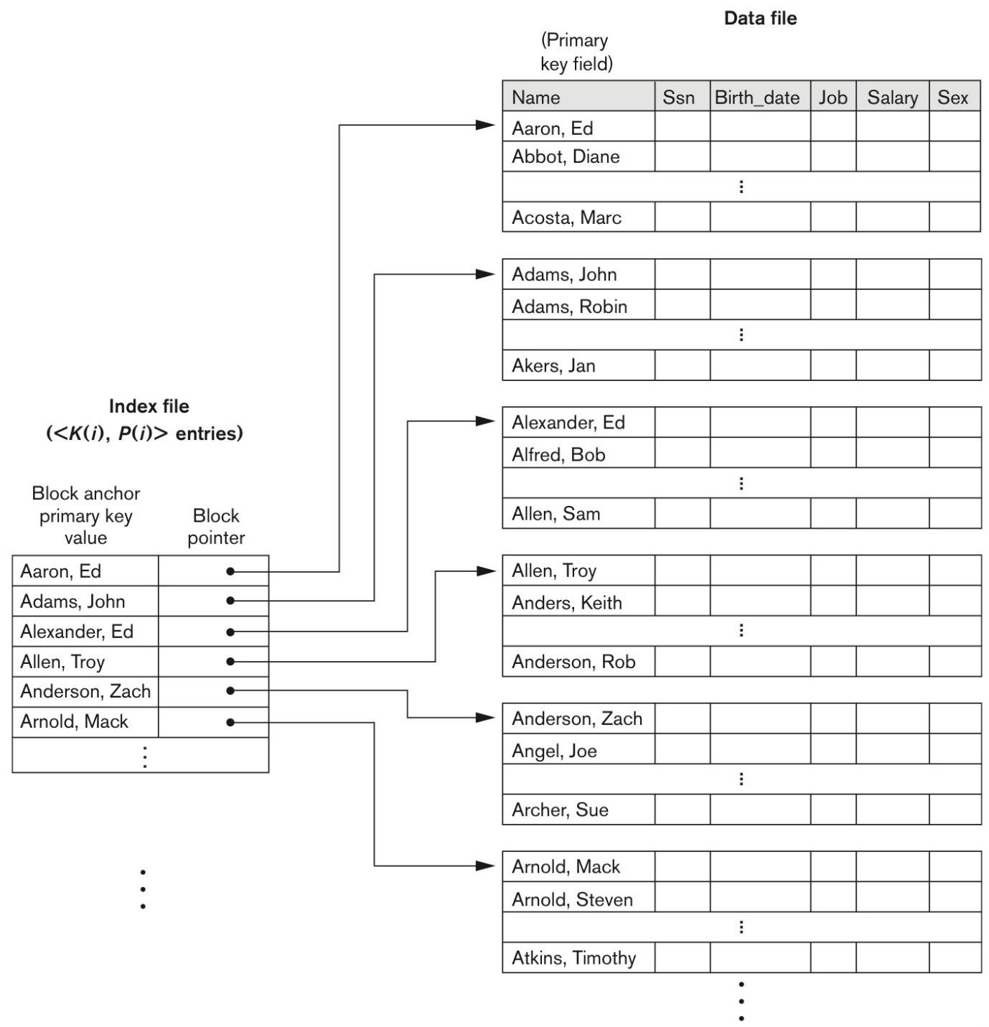
PRIMARY INDEXES (2)
Advantage:
Faster records search & retrieval.
Only (log₂b_{i} + 1) accesses where b_{i} is the number of blocks in index file
Disadvantage:
Insertions & deletions of records are complex.
Move records around & change index values.
Example (binary search on data file without primary indexes):
Ordered file with r = 300 000 records.
Disk block size B = 4096 bytes.
Record length R = 100 bytes.
Blocking factor bfr = ⎣(B/R)⎦ = ⎣(4096/100)⎦ = 40 records per block.
Number of blocks needed b = ⎡(r/bfr)⎤ = ⎡(300000/40)⎤ = 7500 blocks.
Binary search takes ⎡log₂b⎤ = ⎡log₂7500⎤ = 13 block accesses.

Slide 13
PRIMARY INDEXES (2)
Advantage:
Faster records search & retrieval.
Only (log₂b_{i} + 1) accesses where b_{i} is the number of blocks in index file
Disadvantage:
Insertions & deletions of records are complex.
Move records around & change index values.
Example (binary search on primary index file):
Ordering key of file is V which is 9 bytes long.
Block pointer is P which is 6 bytes long.
Size of each index entry is R_{i} which is (9 + 6) = 15 bytes.
Blocking factor for index bfr_{i} = ⎣(B/R_{i})⎦ = ⎣(4096/15)⎦ = 273 entries per block.
Total number of indexes r_{i} = total number of blocks in data file = 7500.
Number of index blocks b_{i} = ⎡(r_{i} /bfr_{i})⎤ = ⎡(7500/273)⎤ = 28 blocks.
Binary search takes ⎡log₂b_{i} ⎤ = ⎡log₂28⎤ = 5 block accesses.
Total number of accesses to search for record = 6 accesses (bin +1).

Slide 14
CLUSTERING INDEXES (1)
Clustering index is used when data file is ordered on a non-key attribute.
Ordering attribute is not unique.
Clustering index is an ordered file with two fields:
Clustering attribute K(i).
Indexing attribute.
Pointer to disk block P(i).
Points to the first block that has a record with the value of a clustering field.
Clustering index file contains one index entry for each distinct value of clustering attribute.
Sparse index.

Slide 15
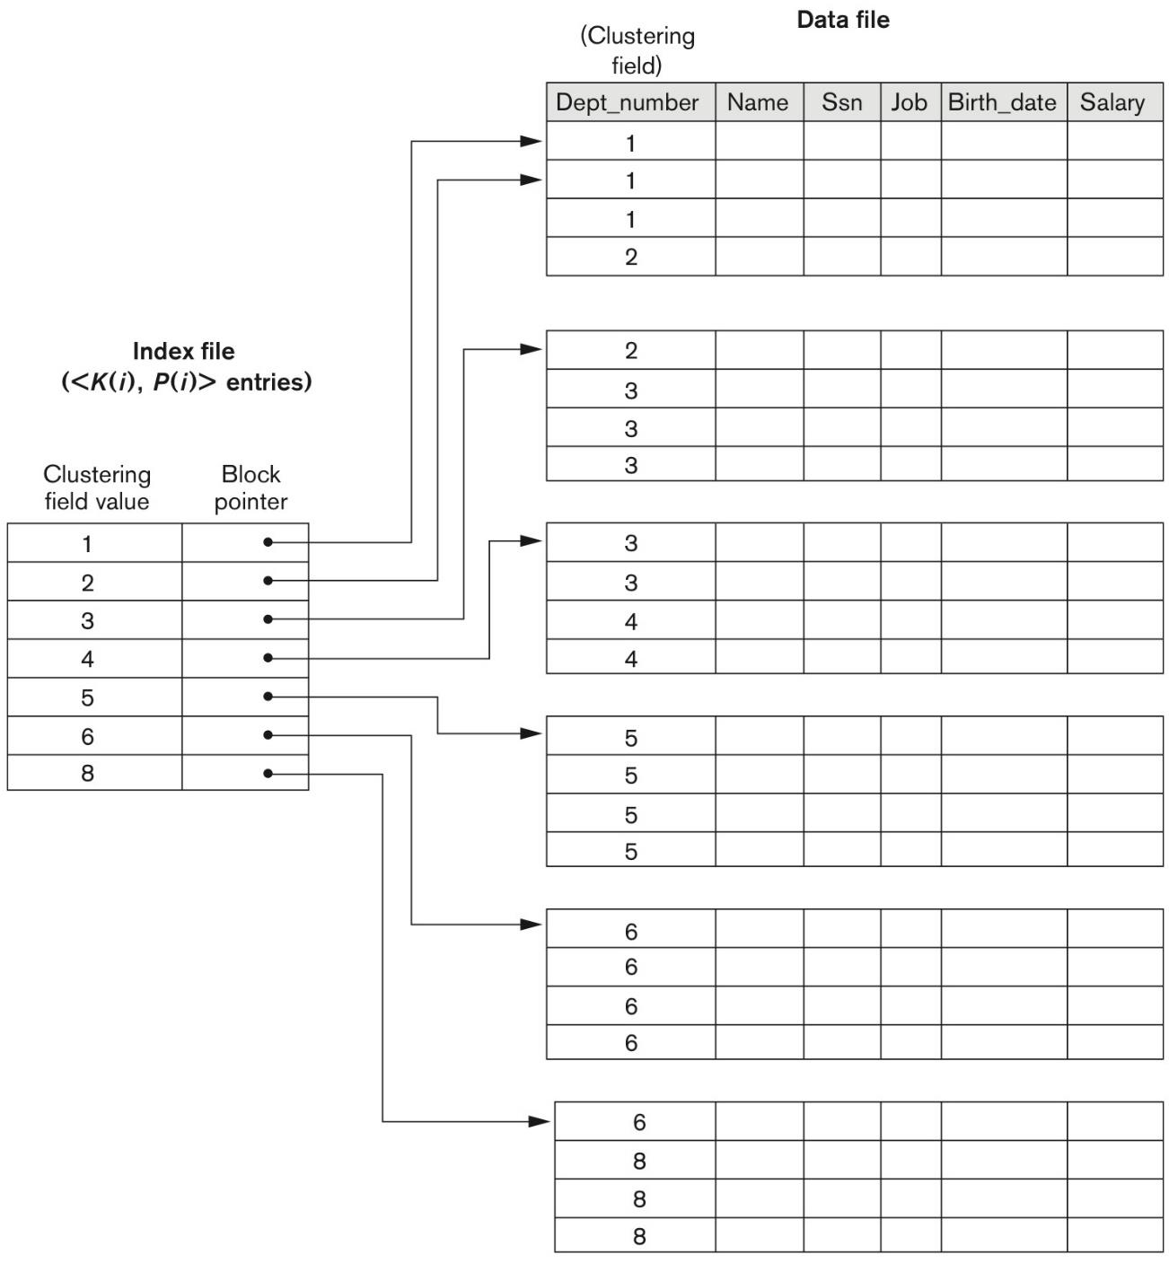
CLUSTERING INDEXES (2)
Advantage:
Faster records search & retrieval.
Only (log₂b_{i} + 1) accesses.
Disadvantage:
Insertions & deletions of records are complex.
Move records around & change index values.

Slide 16
SECONDARY INDEXES (1)
Secondary index is defined over a non-ordering attribute(s) of a record.
Provides secondary access when primary access already exists.
Secondary index can be defined over:
Candidate key attribute (unique).
Dense index.
Non-key attribute (duplicated).
Sparse index.
Secondary index is an ordered file with two fields:
Non-ordering attribute K(i).
Indexing attribute.
Pointer to disk block or record P(i).

Slide 17
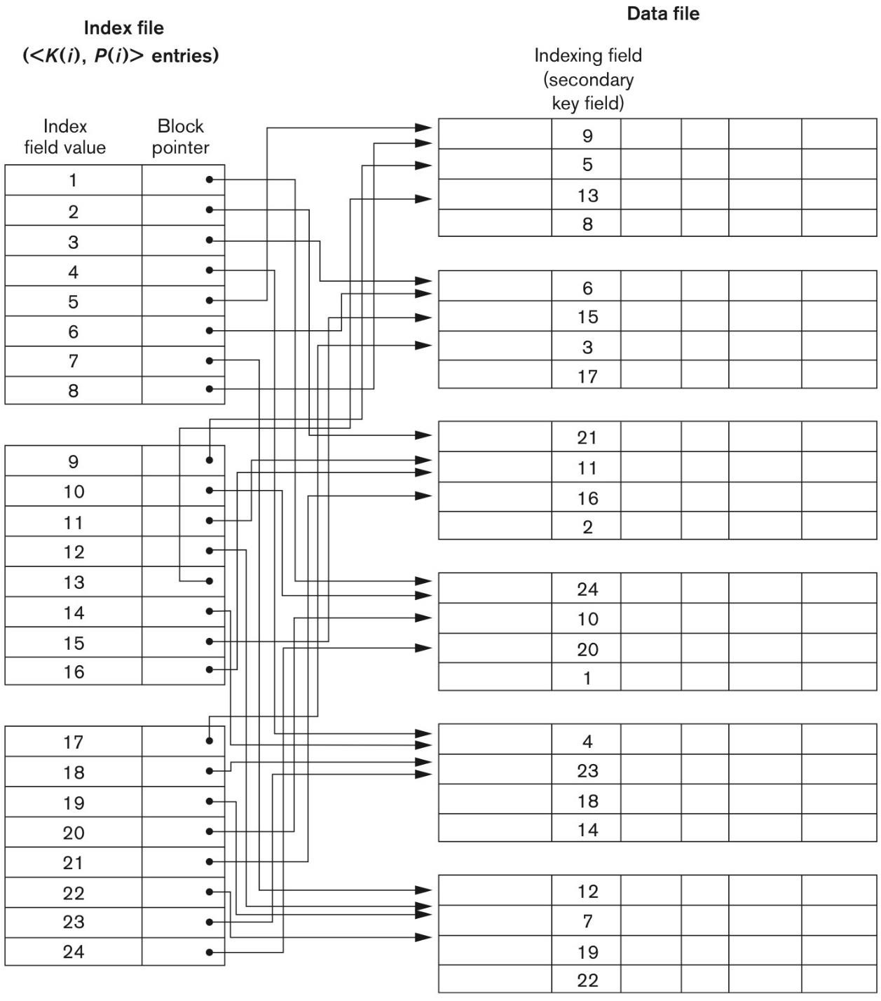
SECONDARY INDEXES (2)
Secondary index provides logical ordering of the
records by indexing attribute.
Secondary index needs more storage space and longer search time compared to primary index.
Contains larger number of entries.
Example:
Same settings as in primary index.
r = 300,000 records.
R = 100 bytes.
B = 4096 bytes.
b = 7500 blocks.
If no primary index → linear search on 7500 blocks = 3750 accesses.
Secondary indexing on non-key value with V = 9 bytes.
P = 6 bytes.
R_{i} = (9 + 6) = 15 bytes.
bfr_{i} = 273 entries per block.

Slide 18
SECONDARY INDEXES (2)
Secondary index provides logical ordering of the
records by indexing attribute.
Secondary index needs more storage space and longer search time compared to primary index.
Contains larger number of entries.
Example (cont.):
Total number of index entries r_{i} = total number of records = 300,000.
Number of blocks needed for index b_{i} = ⎡(r_{i} /bfr_{i})⎤ = ⎡(300,000/273)⎤ = 1099 blocks.
Binary search takes ⎡log₂b_{i} ⎤ = ⎡log₂1099⎤ = 11 block accesses.
Total number of accesses to search for record = 12 accesses (bin +1).
Better than 3750 accesses with no secondary index.

Slide 19
MULTILEVEL INDEXES (1)
Multilevel indexes are aimed to reduce search space when searching through index files.
Index files are sorted → binary search is used to search though indexes → log₂b accesses.
Applying indexing on index files → log_{n}b accesses, where n >> 2.
Multilevel indexing forms a hierarchy structure (tree-like):
Index file.
First (base) level of a multilevel index.
Second level.
Primary index to the first level.
Third level.
Primary index to the second level.
If no more levels – considered top index level.
Multilevel indexing is referred by Indexed Sequential Access Method (ISAM) organization.

Slide 20
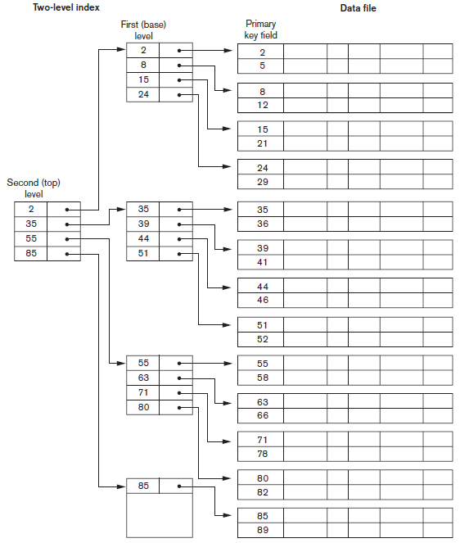
MULTILEVEL INDEXES (2)
Multilevel indexes considerably reduce number of
accesses needed to retrieve a record.
Insertion & deletion of records still involves complex
operations.
Solution – dynamic multilevel indexing.
Example:
Same settings as in secondary index.
r = 300,000 records.
R = 100 bytes.
B = 4096 bytes.
b = 7500 blocks.
P = 6 bytes. V = 9 bytes.
R_{i} = (9 + 6) = 15 bytes.
bfr_{i} = 273 entries per block. Factor n in log_{n}b.

Slide 21
MULTILEVEL INDEXES (2)
Multilevel indexes considerably reduce number of
accesses needed to retrieve a record.
Insertion & deletion of records still involves complex
operations.
Solution – dynamic multilevel indexing.
Example (cont.):
Total number of index entries r_{i} = 300,000.
Number of blocks needed for first-level index b₁ = 1099 blocks.
Number of second-level blocks b₂ = ⎡b₁/n⎤ = ⎡1099/273⎤ = 5 blocks.
Number of third-level blocks b₃ = ⎡b₂/n⎤ = ⎡5/273⎤ = 1 block.
Hence, third level is the top level and number of levels t = 3.
Accessing record by multilevel index requires accessing a block at each level plus one block from data file → 3 + 1 = 4 total accesses needed.

Slide 22
SUMMARY
Fixed-length vs variable-length records.
Unspanned vs spanned records.
Sorted, unsorted & hashed files.
Hashing techniques.
Primary indexes.
Clustering indexes.
Secondary indexes.
Multilevel indexes.

